Slide 1
DETECTION OF LEUKEMIA AND MULTI MYELOMA USING DENSE CONVOLUTIONAL NEURAL NETWORK
Name : GOKUL A
Reg No : 19MTCS07
Under The Guidance
Dr. P. SUMATHY,
Assistant Professor,
Department of Computer Science, Engineering &Application,
Bharathidasan University,
Tiruchirappalli-23.

Slide 2
INTRODUCTION
Leukaemia is a type of cancer that affects the blood and bone marrow, and it is characterized by the abnormal growth of white blood cells. Detecting leukaemia can be done through various methods, such as blood tests and bone marrow biopsies.
One method that has shown promising results in detecting leukemia is through the use of Convolutional Neural Networks (CNNs).
A CNN is a type of artificial neural network that can learn to recognize patterns and features in images or data.
In the case of leukemia detection, a CNN can be trained to recognize the differences between images of normal blood cells and those affected by leukemia.
The CNN would be fed a large number of images of both normal and leukemia-affected blood cells, and it would learn to distinguish between the two based on the patterns and features it recognizes in the images.

Slide 3
PURPOSE OF PROJECT
The purpose of the project is to develop a CNN-based model that can accurately detect leukaemia-affected blood cells from images, providing a fast and reliable diagnosis of the disease.
This can potentially improve the efficiency and accuracy of leukaemia diagnosis and treatment.

Slide 4
BLOCK DIAGRAM
Graphical User Interface
PC
Deep learning (CNN)
Affected
Normal
Detection process
Affected percentage

Slide 5
SOFTWARE REQUIREMETS
HARDWARE SPECIFICATION
SYSTEM : PC or LAPTOP
PROCESSOR : INTEL I5
RAM : 4 GB RECOMMENDED
ROM : 2 GB
SOFTWARE SPECIFICATION
OPERATING SYSTEM : WINDOWS 7/10/11
LANGUAGE USED : PYTHON

Slide 6

PYTHON
Python is a high-level, interpreted programming language that is easy to learn and use.
It has a simple syntax and a large library of modules, making it versatile and powerful for a variety of tasks.
Python is widely used in scientific computing, web development, and data analysis, among other fields.
It is open-source and has a large and active community of developers contributing to its ongoing development and improvement.

Slide 7
ALGORITHM DESCRIPTION
In leukaemia detection using CNNs, the CNN is trained using a large dataset of images of both normal and leukaemia-affected blood cells. The CNN learns to recognize patterns and features in the images that distinguish between normal and affected cells.
When a new image of a blood cell is presented to the CNN, the CNN uses the learned patterns and features to classify the cell as either normal or affected by leukaemia.
The output of the CNN is a probability score, indicating the percentage likelihood that the cell is affected by leukaemia.
By using a CNN to analyse images of blood cells, the system can quickly and accurately identify leukaemia-affected cells, allowing for faster diagnosis and treatment of the disease.

Slide 8
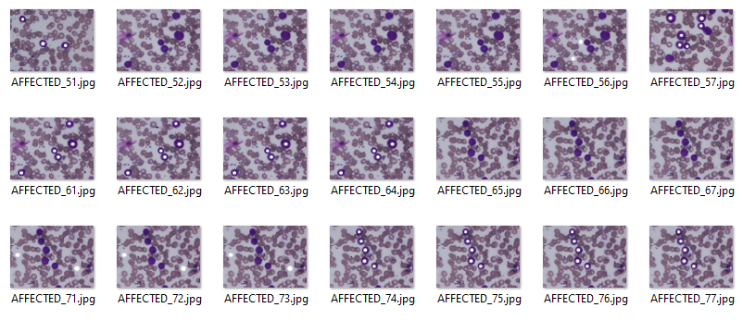
AFFECTED LUKEAMEA CASES

Slide 9
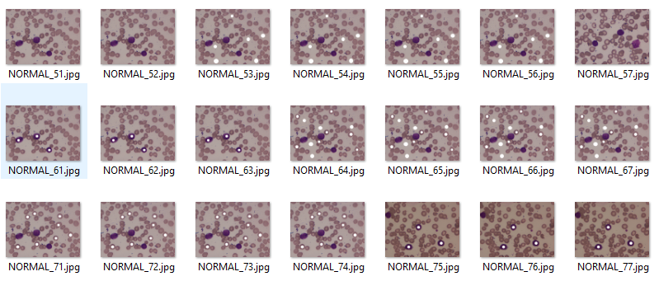
NORMAL LUKEAMEA CASES

Slide 10
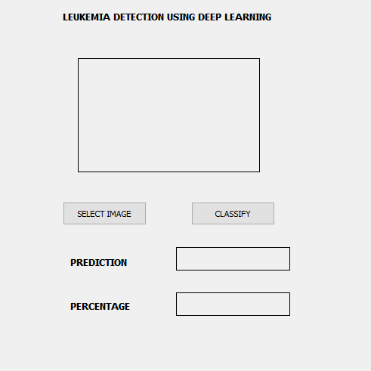
GUI SCREENSHOT

Slide 11
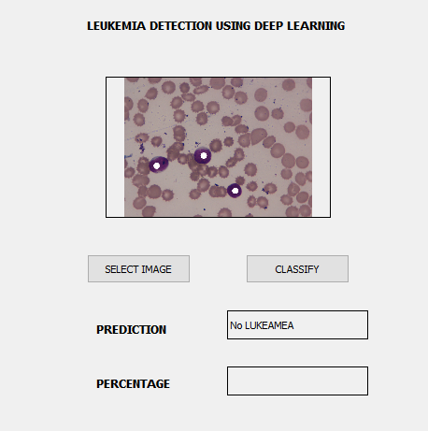
NO LUKEAMEA SREENSHOT

Slide 12
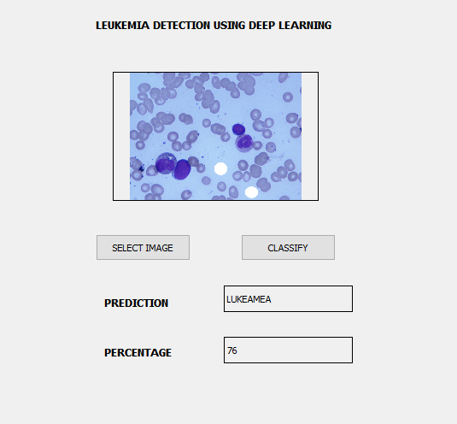
LUKEAMEA SREENSHOT

Slide 13
REFERENCES
(2019).MedicalNewsToday.Accessed:Nov.2,2020.[Online].Available:https://www.medicalnewstoday.com/articles/142595
(2019).MedicalNewsToday.Accessed:Nov.2,2020.[Online].Available:https://www.medicalnewstoday.com/articles/282929
U. Zelig, S. Mordechai, G. Shubinsky, R. K. Sahu, M. Huleihel, E. Leibovitz, I. Nathan, and J. Kapelushnik, ‘‘Pre-screening and followup of childhood acute leukemia using biochemical infrared analysis of peripheral blood mononuclear cells,’’ Biochim. et Biophys. Acta (BBA) Gen. Subjects, vol. 1810, no. 9, pp. 827–835, Sep. 2011.
K.A.S.A. Daqqa, A.Y.A. Maghari, and W.F.M.A. Sarraj, ‘‘Prediction and diagnosis of leukemia using classification algorithms,’’ in Proc. 8th Int. Conf. Inf. Technol. (ICIT), May 2017, pp. 638–643.
N. Mahmood, S. Shahid, T. Bakhshi, S. Riaz, H. Ghufran, and M. Yaqoob, ‘‘Identification of significant risks in pediatric acute lymphoblastic leukemia (ALL) through machine learning (ML) approach,’’ Med. Biol. Eng. Comput., vol. 58, no. 11, pp. 2631–2640, Nov. 2020.

Slide 14
Conclusion
CNN algorithm is a competent and well-known deep learning algorithm that can be used efficiently in significant research areas, especially medical image processing.
CNN can analyze and detect important features from different medical images such as CT scans, X-rays, MRI, PET, ultrasound, and hematological images.
In the future, we are planning to apply the CNN architecture for other types of leukemia cell detection, such as Acute Lymphatic Leukemia (ALL), to get high accuracy.

